Slide 1
IBM CAPSTONE PROJECT – The Battle of Neighborhoods: Determining Business Prospects in Toronto

Slide 2
Business Problem section
Business Questions
What neighborhood to invest in
What business to invest in

Slide 3
Solution
Clustering Toronto neighborhoods in order to recommend neighborhoods and business prospects to invest in.

Slide 4
Data and Methodology
Data: For this project, we make use of Neighbourhood data in Toronto, longitude and latitudes of the boroughs, and Four square API.
Methodology:
Collect Inspection Data;
Explore and Understand Data;
Data preparation and preprocessing;
Modeling

Slide 5
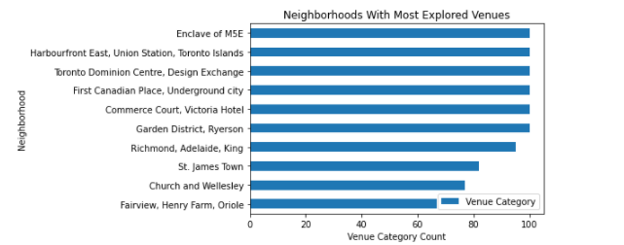
Data Visualization
Top 10 most explored Neighborhoods

Slide 6
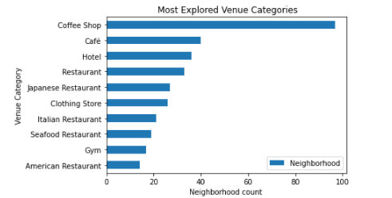
Data Visualization
The top 10 most explored venues in the top neighborhoods

Slide 7
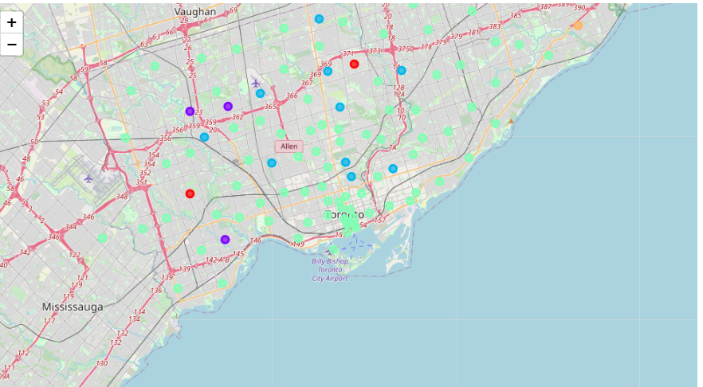
Kmeans Clustering

Slide 8
Results:
Examination of Busy Neighborhoods in Toronto
For busy neighborhoods, areas like Church and Wellesley, First Canadian Place, Underground city, Enclave of M5E, Commerce Court, Victoria Hotel, Toronto Dominion Centre, Design Exchange and businesses like: coffee shop, cafe, hotel or restaurant are recommended.
Examination of clustered Neighboothoods
cluster 0, the most profitable business choice will be Cafeteria, Yoga Studio or Eastern European Restaurant.
cluster 1, the most profitable business choice will be baseball field, home service and yoga studio.
cluster 2, the most profitable business choice will be Park or Convenience Store.
cluster 3, the most profitable business choice will be Coffee Shop, Cafe or Pizza Place
cluster 4, the most profitable business choice will be Cafeteria, Bar Yoga Studio.

